Slide 1
Announcements
Mid-semester Survey is out
2 points EC for everyone if 90% of students fill it out
There’ll be a Project 2 Party this Sunday, 11-1PM
2nd floor Soda labs
A few potentially helpful methods have been added to gitlet.Utils
To get them, do `git pull gitlet-skeleton` in your group repo
Additional tests will be added to the skeleton later this week; you’ll be able to get those by re-pulling as well
In lecture live Piazza Q&A @513
TAs will answer your questions

Slide 2
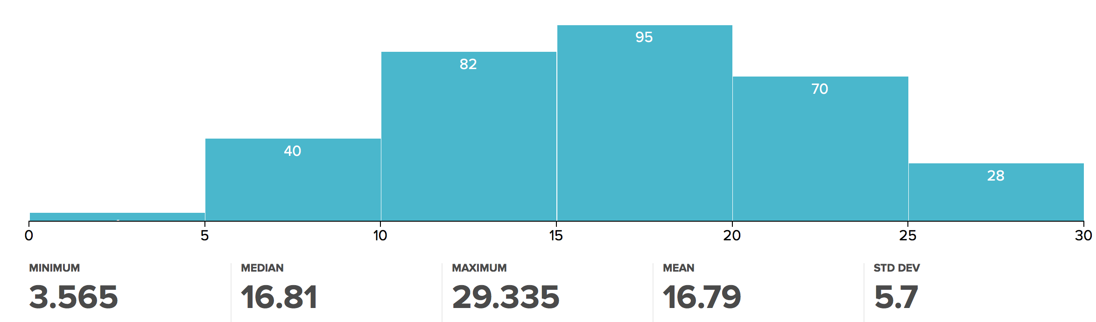
Midterm Notes
Mean might be lower than you’re used to
It’ll be okay!
Regrades due by Friday at noon!

Slide 3

CS61BL, Summer 2017
Lecture 3: Abstract Data Types, Gitlet, Java 8, Trees

Slide 4
Abstract Data Types

Slide 5
Nomenclature
An abstract data type is a model for how we can interact with data
An ADT is defined by what operations it supports and how these operations behave
Basically an interface, such as List or Set
Describes how the data type should behave, but not how it should be implemented
A data structure is a concrete implementation of an abstract data type
ArrayList, DLList, etc.

Slide 6

List
The List ADT supports the following operations:
Create an empty list
Add an item to the list at a given position
Get an item from the list at a given position
Check if an item is already in the list
Useful implementations: ArrayList, LinkedList
Lists are ordered, use them to store a collection of items that have a specific order!

Slide 7
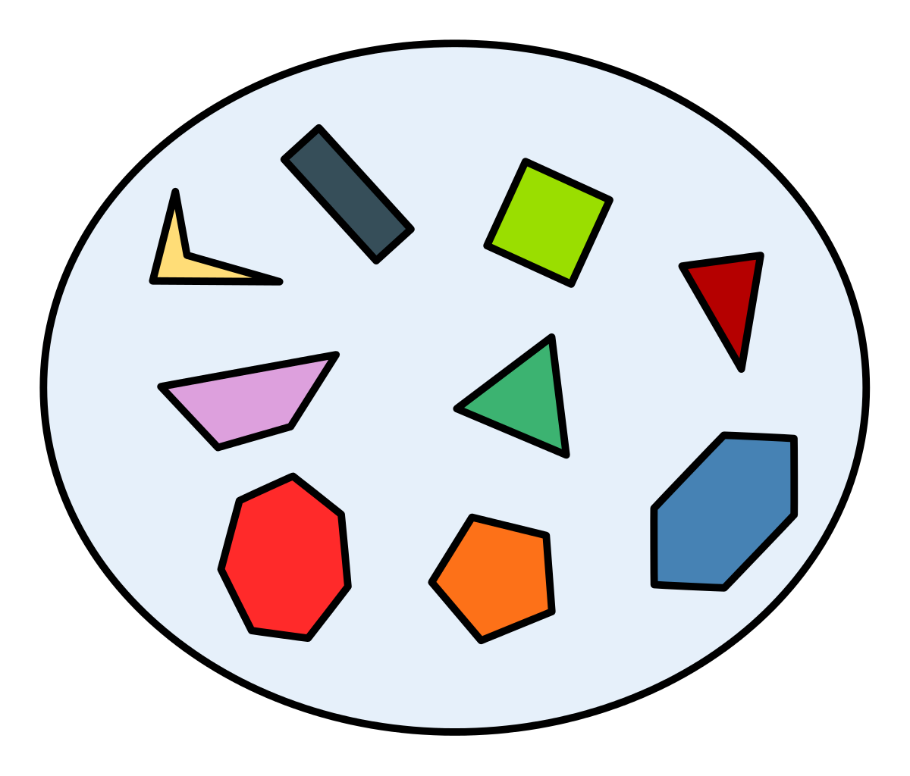
Set
The Set ADT supports the following operations:
Create an empty set
Add an item to the set
Check if an item is already in the set
Useful implementations: HashSet, TreeSet
Sets aren’t ordered, use them to store a collection of items that have no specific order
A sometimes-useful property of sets is that they don’t contain duplicates!

Slide 8
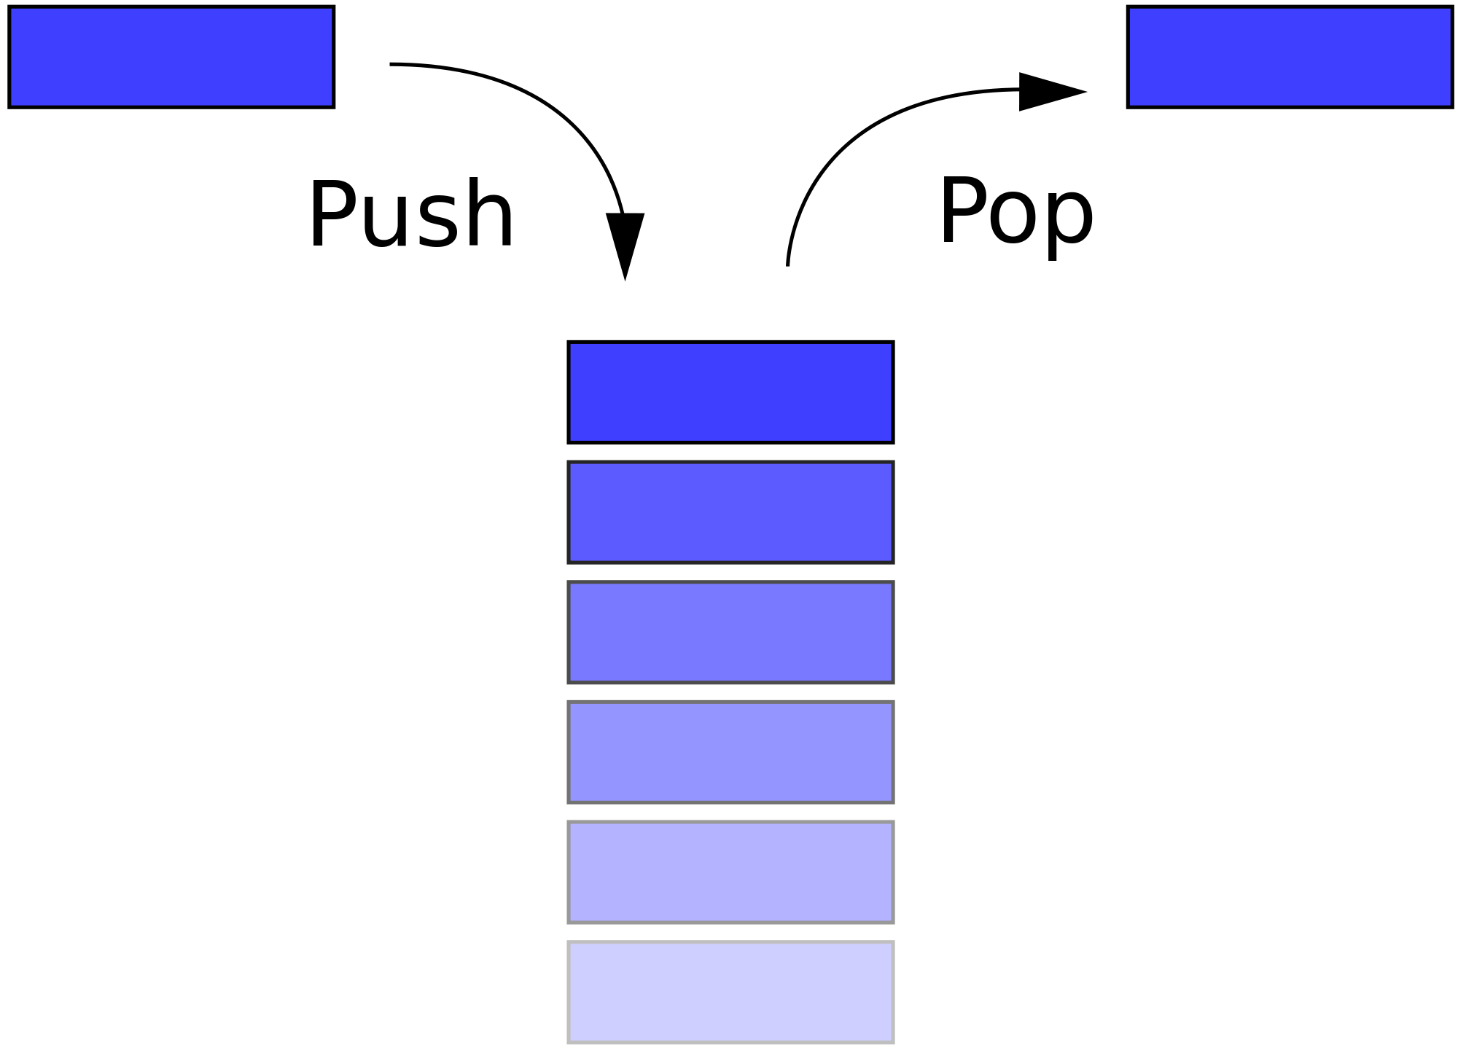
Stack
The Stack ADT supports the following operations:
Create an empty stack
Add an item to the stack
Check the most recent item added to the stack
Remove the most recent item added
Useful implementations: LinkedList
Stacks are useful if you’re always interested in the most recent item added to the collection
Not really a stack, but can be used like one

Slide 9
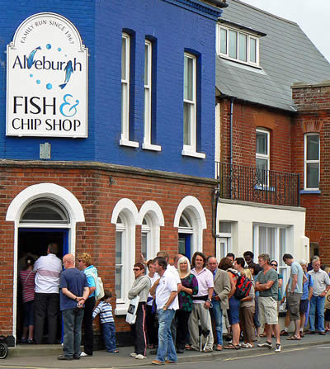
Queue
The Queue ADT supports the following operations:
Create an empty queue
Add an item to the queue
Check the oldest item added to the queue
Remove the oldest item added
Useful implementations: LinkedList
Queues are useful if you’re always interested in the oldest item added to the collection. Opposite of a stack!
Not really a queue, but can be used like one

Slide 10
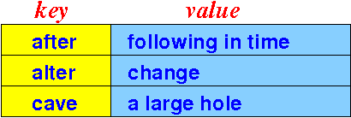
Map (aka dictionary)
The Map ADT supports the following operations:
Create an empty map
Add a key with a value to the map
Check if a key is in the map
Look up the value of a given key
Update the value of a given key
Useful implementations: HashMap, TreeMap
Maps are useful if we want to store key-value pairs. What aren’t they good for?

Slide 11
Why Think About Abstract Data Types?
We can think about how to solve problems purely using ADTs!
Don’t have to think about data type implementation details while designing a program
Keep the aforementioned abstract data types in mind as you ponder your Gitlet design!

Slide 12
Git(let) Basics
Simplified, in the interest of time.

Slide 13
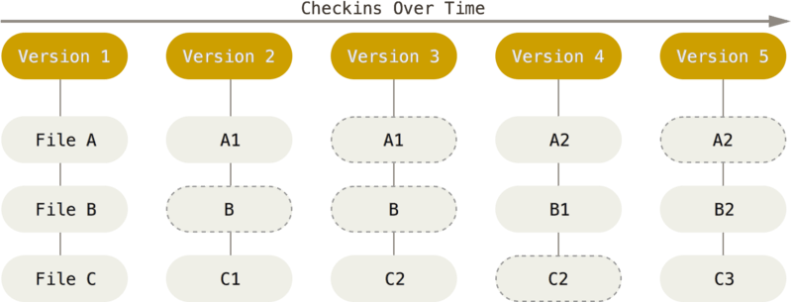
A Snapshot Control System
When you add and commit a file, Git takes a complete snapshot of that file
Git thinks about the history of your files as a “stream of snapshots”
This allows us to retrieve the snapshot of any tracked file as it existed in any version
Dotted border indicates that this snapshot rolled over from previous commit
These are all snapshots

Slide 14
A Snapshot Control System
When you add and commit a file, Git takes a complete snapshot of that file
Git thinks about the history of your files as a “stream of snapshots”
This allows us to retrieve the snapshot of any tracked file as it existed in any version
Permanently backing up a file involves two steps: adding and committing.

Slide 15
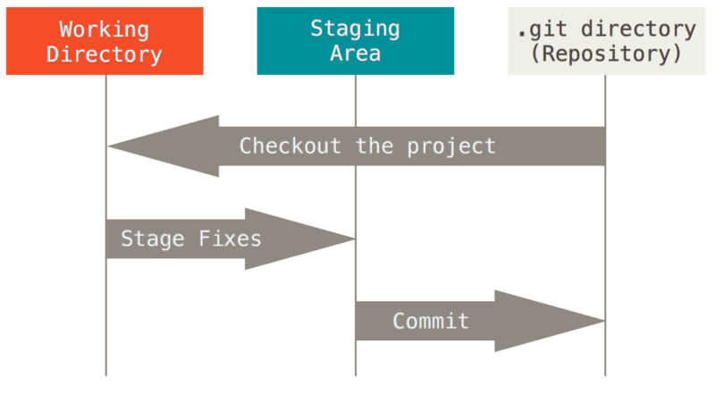
The Three Sections of Git
All Git projects have three main sections...
Working directory: where you work with a given version of your project
Staging area: stores information about what will go into your next commit
Repository: stores metadata and every snapshot you’ve ever taken

Slide 16
The Staging Area (also known as the index)
When you perform a `git add`, Git takes a snapshot of your file and records that this snapshot is to be backed up in the staging area
Working directory
.git
wug.txt
Staging area
hi

Slide 17
The Staging Area (also known as the index)
When you perform a `git add`, Git takes a snapshot of your file and records that this snapshot is to be backed up in the staging area.
git add wug.txt
A snapshot of wug.txt is added to the staging area
At this point, backup of wug.txt has yet to be finalized
Working directory
.git
wug.txt
Staging area
hi
wug.txt
hi

Slide 18
Important Terminology: Blobs
Snapshots are stored in Git as blobs
Blobs are the contents of a file at a given snapshot
These snapshots are all backed up as blobs

Slide 19
The Staging Area (also known as the index)
After adding, subsequent changes to wug.txt will not affect the blob in the staging area, unless wug.txt is re-added
Working directory
.git
wug.txt
Staging area
hi
wug.txt
hi

Slide 20
The Staging Area (also known as the index)
After adding, subsequent changes to wug.txt will not affect the blob in the staging area, unless wug.txt is re-added
Working directory
.git
wug.txt
Staging area
salutations
wug.txt
hi

Slide 21
Leaving the Staging Area
When you perform a `git commit`, Git moves your blobs out of the staging area and records them forever
git commit -m “First commit!”
Makes a commit that saves wug.txt’s state when it was added
Staging area is cleared
Working directory
.git
wug.txt
Staging area
salutations
wug.txt
hi

Slide 22
Leaving the Staging Area
When you perform a `git commit`, Git moves your blobs out of the staging area and records them forever
git commit -m “First commit!”
Makes a commit that saves wug.txt’s state when it was added
Staging area is cleared
Working directory
.git
Commit ID
Commit 1
Staging area
“First commit!”
Description
wug.txt
wug.txt
Files backed up
salutations
wug.txt
hi

Slide 23
A Problem: Namespace Collisions
What if we add and commit a new version of wug.txt?
Working directory
.git
Commit 1
Staging area
“First commit!”
wug.txt
wug.txt
salutations
wug.txt
hi

Slide 24
A Problem: Namespace Collisions
What if we add and commit a new version of wug.txt?
git add wug.txt
Working directory
.git
Commit 1
Staging area
“First commit!”
wug.txt
wug.txt
wug.txt
salutations
salutations
wug.txt
hi

Slide 25
A Problem: Namespace Collisions
What if we add and commit a new version of wug.txt?
git add wug.txt
git commit -m “Second!”
Which one?
Working directory
.git
Commit 1
Commit 2
Staging area
“First commit!”
“Second!”
wug.txt
wug.txt
wug.txt
salutations
wug.txt
wug.txt
hi
salutations

Slide 26
A Solution: Content-Addressable Storage
Content-addressable storage means we’ll name our blobs based on their content
How can we convert file content into a name?

Slide 27
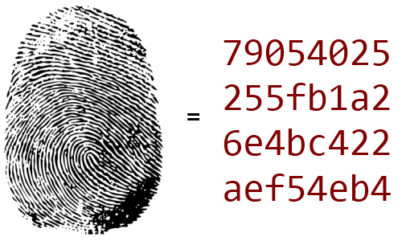
Hashing
A hash function is a function that accepts as input data of arbitrary size, and spits out a digest of fixed size
Hash functions allow us to summarize data of arbitrary size
An object’s hash can be used to identify the content that has been hashed

Slide 28
SHA-1
The hash function used by both Git and Gitlet is SHA-1
SHA-1 produces a 160-bit digest from arbitrarily large data
For our purposes, we’ll interpret this digest as a string that we can use to name our files
Looks something like: 73105aa6ce9805a… (40 characters long)
For Gitlet, see the Utils.java file for help
What if SHA-1 produces the same hash for two different blobs?
This is possible, but extremely unlikely

Slide 29
SHA-1
For each snapshot of wug.txt, we hash that blob’s contents and use the hash to name the blob
hi → a9f6b23fca55b45c1de226...
salutations → b3d2399175fdc5c31...
Commit objects map file names to hash IDs
Working directory
.git
Commit 1
Commit 2
Staging area
“First commit!”
“Second!”
wug.txt
wug.txt → a9..
wug.txt → b3..
salutations
a9f6b...
b3d23...
hi
salutations

Slide 30
SHA-1
We can identify commits the same way!
Commits can be identified by the hash of their content
“First commit!” + (wug.txt → a9..) → 93b24ca95a12...
“Second!” + (wug.txt → b3..) → c22da8d636e99...
Commit objects saved in the .git folder with these names
Working directory
.git
93b24ca95...
c22da8d6...
Staging area
“First commit!”
“Second!”
wug.txt
wug.txt → a9..
wug.txt → b3..
salutations
a9f6b...
b3d23...
hi
salutations

Slide 31
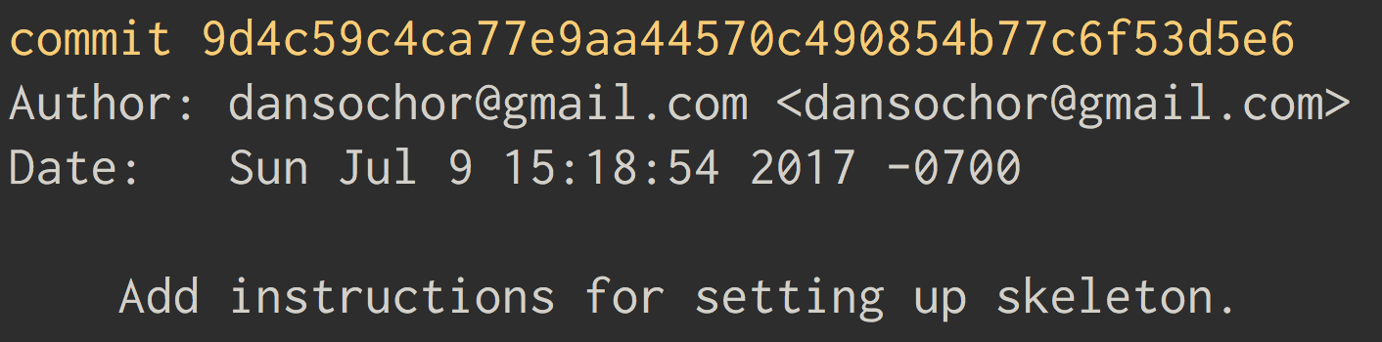
SHA-1
SHA-1 is where the crazy commit ID strings in Git come from!

Slide 32
Branching

Slide 33

An Aside: Branching
Branching allows you to diverge from the main line of development and continue working without messing with that main line
Can later merge your branch back into the main line
Great for writing experimental code
But how does it work?

Slide 34
What is a Branch?
A branch is just a special name for a commit
Git and Gitlet’s default branch name is master
master
93b24ca95...

Slide 35
What is a Branch?
A branch is just a special name for a commit
Git and Gitlet’s default branch name is master
When you make a new commit, your branch pointer moves forward automatically
New commit
master
93b24ca95...
c22da8d6...

Slide 36
What is a Branch?
A branch is just a special name for a commit
Git and Gitlet’s default branch name is master
When you make a new commit, your branch pointer moves forward automatically
Can make a new branch with the branch command
Creates a new branch pointing to the commit you’re currently on
master
93b24ca95...
c22da8d6...

Slide 37
What is a Branch?
A branch is just a special name for a commit
Git and Gitlet’s default branch name is master
When you make a new commit, your branch pointer moves forward automatically
Can make a new branch with the branch command
Creates a new branch pointing to the commit you’re currently on
Example: git branch testing
master
testing
93b24ca95...
c22da8d6...

Slide 38
How Does Git Know What Branch You’re On?
Git maintains a special pointer to the branch you’re currently on, called HEAD
HEAD
master
testing
93b24ca95...
c22da8d6...

Slide 39
How Does Git Know What Branch You’re On?
Git maintains a special pointer to the branch you’re currently on, called HEAD
When you check out another branch, HEAD changes
Example: git checkout testing
HEAD
master
testing
93b24ca95...
c22da8d6...

Slide 40
How Does Git Know What Branch You’re On?
Git maintains a special pointer to the branch you’re currently on, called HEAD
When you check out another branch, HEAD changes
Example: git checkout testing
HEAD
master
testing
93b24ca95...
c22da8d6...

Slide 41
An Aside: Branching
Git maintains a special pointer to the branch you’re currently on, called HEAD
When you check out another branch, HEAD changes
Example: git checkout testing
Further commits will now advance the newly checked-out branch pointer
HEAD
master
testing
93b24ca95...
c22da8d6...

Slide 42
An Aside: Branching
Git maintains a special pointer to the branch you’re currently on, called HEAD
When you check out another branch, HEAD changes
Example: git checkout testing
Further commits will now advance the newly checked-out branch pointer
HEAD
master
testing
93b24ca95...
c22da8d6...
e6a23d6d...
New commit

Slide 43
An Aside: Branching
We can resume progress on the main branch by checking it out and proceeding as usual
Example: git checkout master
This moves HEAD and returns your working directory to its state at the commit that master points to
HEAD
master
testing
93b24ca95...
c22da8d6...
e6a23d6d...

Slide 44
An Aside: Branching
We can resume progress on the main branch by checking it out and proceeding as usual
Example: git checkout master
This moves HEAD and returns your working directory to its state at the commit that master points to
HEAD
master
testing
93b24ca95...
c22da8d6...
e6a23d6d...

Slide 45
An Aside: Branching
Now, making a new commit creates a split between the two branches
HEAD
master
testing
93b24ca95...
c22da8d6...
e6a23d6d...

Slide 46
An Aside: Branching
Now, making a new commit creates a split between the two branches
New commit
HEAD
bf1g4980a...
master
93b24ca95...
c22da8d6...
e6a23d6d...
testing

Slide 47
An Aside: Branching
Now, making a new commit creates a split between the two branches
These branches can be merged back together using Git’s merge command
Git and Gitlet have divergent merge behavior, so we won’t discuss merging too much here
New commit
HEAD
bf1g4980a...
master
93b24ca95...
c22da8d6...
e6a23d6d...
testing

Slide 48
Merge Conflict Demo

Slide 49
Git Summary
Git is a stream of snapshots
Snapshots are added to the staging area as blobs by the add command
Blobs are permanently backed up when they are committed
Blobs and commits are addressed according to SHA-1s of their content
Commits and the staging area are responsible for remembering which blobs correspond to which files
A branch is a special name for a commit
HEAD tells us which branch we’re currently on

Slide 50
Git Summary
Git (and Gitlet) manage a lot of information!
Blobs, commits, branches, HEAD, the staging area…
The difficulty of Gitlet is in storing and retrieving this information
Working directory
.git
93b24ca95...
c22da8d6...
Staging area
“First commit!”
“Second!”
wug.txt
de41a..
wug.txt → a9..
wug.txt → b3..
greetings
greetings
a9f6b...
b3d23...
master
hi
salutations
HEAD

Slide 51
Persistence

Slide 52
Gitlet and Persistence
Every command you issue to Gitlet goes through Gitlet’s main method
java gitlet.Main add wug.txt
java gitlet.Main commit “First commit!”
Each of the above commands starts a new Java process
All variables declared during the run of a Java program are destroyed when the program’s main method returns
So how do we store all of the progress we made between runs of Gitlet.Main?
Gitlet must save its state to the file system!

Slide 53
The File System
Java can interact with the file system using the File class
File objects represent a path to a file or directory that may or may not exist in your file system
Example: File f = new File(“/Users/dansochor/cs61bl/1”) represents the path to my personal repo in my file system
To access a file or directory, one must assemble the path to that file or directory
Gitlet will primarily be concerned with files in the directory where it’s running

Slide 54
The File System: a Demo
/* Make a File that represents the path to the
directory where Gitlet is running. */ File pwd = new File(System.getProperty("user.dir")); /* Append "/.gitlet" to whatever path was created
above. */ File gitlet_dir = new File(pwd, ".gitlet"); /* Create the .gitlet directory! */ gitlet_dir.mkdir();
The File class can do all kinds of useful stuff! Documentation here. Also, see Utils.java for helpful methods!

Slide 55
The File System
The File class, along with the methods in Utils.java, will allow us to easily read and write data between files
Extremely helpful for saving blobs in the .gitlet directory
Writing blobs basically requires that we read bytes from one file and write those bytes to another
What about storing more complicated information that we generate ourselves, like commits?
Do we need to define a commit file format?

Slide 56
Serialization
Serialization allows us to save our Java objects to disk!
All we need to do to make an object Serializable is implement the Serializable interface
Works like magic!
Makes it really easy to track things like commits… just make Commit objects and write them to disk!
Things to note:
Serialization follows pointers, so all instance variables of an object are serialized along with the object itself
Static variables are not serialized!
Code to save and retrieve Serializable objects is in the spec!

Slide 57
So, Which Classes Should Be Serializable?
Recall that we need to keep track of:
Blobs, commits, branches, HEAD, and the staging area
The design for this project is open-ended, but here are some suggestions:
The classes representing the staging area and your commits should be serializable
Remember that there is only one staging area!
Blobs can be plain text files, but they can also be serializable objects that contain byte arrays (file data)
Likewise, branches and HEAD can be text files, or serializable objects that contain Strings
You probably want at least one additional class to handle Gitlet commands in general; gitlet.Main should have very little code in it

Slide 58
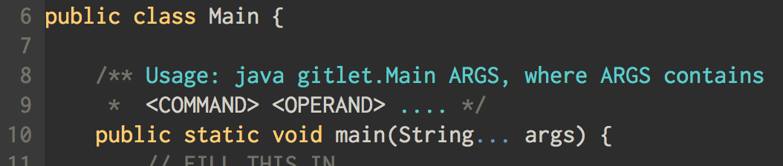
By the way, what’s the deal with String... args?
This syntax allows main to accept any number of Strings as arguments, rolling them into an array
Example: java gitlet.Main add wug.txt
0
1
String[] args
“add”
“wug.txt”

Slide 59
Break (5 minutes)

Slide 60
HOFs

Slide 61
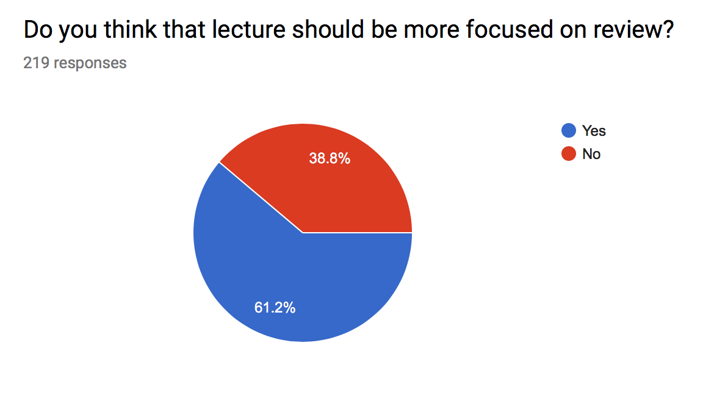
Aside: Apparently You Want Review

Slide 62
Higher-Ordered Functions
Higher Order Function: A function that treats another function as data.
e.g. takes a function as input.
Example in Python:
def tenX(x):
return 10*x
def do_twice(f, x):
return f(f(x))
print(do_twice(tenX, 2))
200

Slide 63
How-to HOF in the Old Days
Slight Problem: Java 7 doesn’t have references to functions (methods). Functions aren’t Objects

Slide 64
How-to HOF in the Old Days
Slight Problem: Java 7 doesn’t have references to functions (methods). Functions aren’t Objects
Fix: Define an interface and create wrapper classes for functions that implement the interface
IntUnaryFunction
apply(int)
TenX
apply(int)

Slide 65
How-to HOF in the Old Days
public interface IntUnaryFunction {
int apply(int x);
}
def tenX(x):
return 10*x
def do_twice(f, x):
return f(f(x))
print(do_twice(tenX, 2))
public class TenX implements IntUnaryFunction {
public int apply(int x) {
return 10 * x;
}
}
public class HoFDemo {
public static int do_twice(IntUnaryFunction f, int x) {
return f.apply(f.apply(x));
}
public static void main(String[] args) {
System.out.println(do_twice(new TenX(), 2));
}
}

Slide 66
How-to HOF: New Way
HOFs are now built into Java 8!!
Java will automatically wrap methods into Objects for you!!
No longer have to make custom interfaces and classes
New Syntax
Class::methodName to pass around methods
All the built in Functions

Slide 67
How-to HOF: New Way
def tenX(x):
return 10*x
def do_twice(f, x):
return f(f(x))
print(do_twice(tenX, 2))
public class HoFDemo {
public static int tenX(int x) {
return 10 * x;
}
public static int do_twice(Function<Integer, Integer> f,
int x) {
return f.apply(f.apply(x));
}
public static void main(String[] args) {
System.out.println(do_twice(HoFDemo::tenX, 2));
}
}

Slide 68
But wait, there’s more!
Java 8 also introduced lambda functions (anonymous functions)
Good for one use functions, you can write even less code!!
public class HoFDemo {
public static int do_twice(Function<Integer, Integer> f,
int x) {
return f.apply(f.apply(x));
}
public static void main(String[] args) {
System.out.println(do_twice(x -> 10 * x, 2));
}
}

Slide 69
Comparators

Slide 70


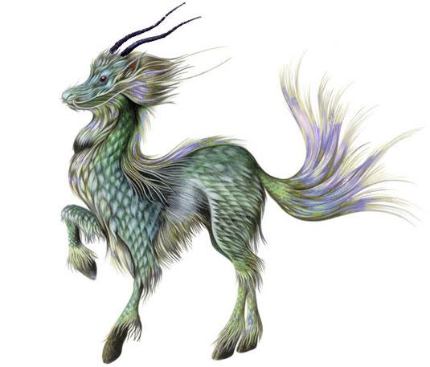
A Natural Ordering
The term “Natural Order” is sometimes used to refer to the ordering implied by a Comparable’s compareTo method.
Example: Dog objects could have a natural order given by their size.
“Doge”, size: 5
“Jarmigon”, size: 200
“Clifford”, size: 9001

Slide 71
Example: Arrays.sort
sort will by default arrange the elements by their natural ordering (i.e. their size)
public static void main(String[] args) {
Dog[] l = {new Dog("Jarmigon", 200), new Dog("Doge", 5),
new Dog("Clifford", 9001)};
System.out.println(Arrays.toString(l));
Arrays.sort(l);
System.out.println(Arrays.toString(l));
}

Slide 72
Let’s go against nature
What if you wanted to order Dogs by their name?
Option 1: Redefine the natural ordering
Option 2: Bring in a third-party to help: a Comparator
“Doge”, size: 5
“Clifford”, size: 9001
“Jarmigon”, size: 200

Slide 73
Comparators: Back in the Days of Yore
public class NameComparator implements Comparator<Dog> {
public int compare(Dog d1, Dog d2) {
return d1.name.compareTo(d2.name);
}
}
}

Slide 74
Comparators: Back in the Days of Yore
public class NameComparator implements Comparator<Dog> {
public int compare(Dog d1, Dog d2) {
return d1.name.compareTo(d2.name);
}
}
}
public static void main(String[] args) {
Dog[] l = {new Dog("Jarmigon", 200), new Dog("Doge", 5),
new Dog("Clifford", 9001)};
System.out.println(Arrays.toString(l));
Arrays.sort(l, new NameComparator());
System.out.println(Arrays.toString(l));
}

Slide 75
Comparators: New Way
Programmers are lazy, why type when you don’t have to
Comparators are a Functional Interface
We only make Comparator objects for one method, the compare method
Compare takes in two objects and returns an int
Java 8 allows us to just pass in a function that substitutes for the Comparator
i.e that function also takes in two objects and returns an int

Slide 76
Arrays.sort Revisited
public static void main(String[] args) {
Dog[] l = {new Dog("Jarmigon", 200), new Dog("Doge", 5),
new Dog("Clifford", 9001)};
System.out.println(Arrays.toString(l));
Arrays.sort(l, (d1, d2) -> d1.name.compareTo(d2.name));
System.out.println(Arrays.toString(l));
}

Slide 77

Streams

Slide 78
Streams: An Assembly Line
A way of processing data in a sequential manner
Requires a different manner of thinking: chaining operations
Has other nice properties like parallelism (see CS61C)
All Collections in Java can be turned into streams
Why streams when we already have collections?
Collections are about the data, streams are about computations

Slide 79
MainStream Intermediate Operations
stream()
Must first call .stream() to convert a collection into stream
sorted()
Sorts the stream
Can pass in a Comparator (i.e a lambda) to defy natural ordering of the Stream
map(Function f)
Applies the function on each of the elements of the stream
filter(Predicate p)
Tests each element to determine if it should remain in the stream

Slide 80
MainStream Terminal Operations
reduce(BinaryOperator accumulator)
Applies the accumulator and combines elements in the stream, two at a time
Returns an Optional
collect(Collector c)
Turns the stream into a collection

Slide 81
Optionals
Sometimes, the stream may end up being empty (i.e after a filter)
Optionals are container objects that may or may not have a value
To get the value, you must call .orElse(T default)
Will return you the value in the Optional, or else returns the default you specified

Slide 82
Collectors
collect is a flexible method, can turn a stream into any Collection
Uses a Collector object that helps do the actual collecting
Collectors.toList() returns a Collector that creates Lists
Collectors.toSet() returns a Collector that creates Sets
Collectors.groupingBy(Function f) returns a Collector that uses f to group the elements in the stream
Creates a Map

Slide 83
Demo

Slide 84
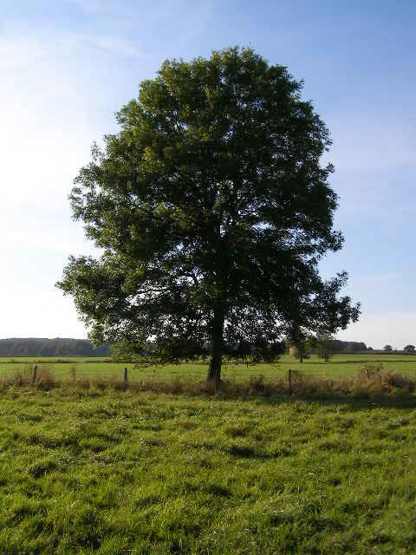
Trees

Slide 85
Trees
A tree consists of:
A set of nodes.
A set of edges which connect pairs of nodes.
Requirements:
Connected - there is a path from any node to another node along the edges.
If there are N nodes, there are N-1 edges.
Can be rephrased as: there is exactly one path between each pair of nodes.

Slide 86
Common Example: File Folders
/home/daniel
games/
images/
downloads/
school/
FFXV/
KHIII/
pdfs/
cs61bl/
old/
lectures/
labs/

Slide 87
Rooted Trees and Rooted Binary Trees
In a rooted tree, we call one node the root.
Every node N except the root has exactly one parent, defined as the first node on the path from N to the root.
Unlike (most) real trees, the root is usually depicted at the top of the tree.
A node with no child is called a leaf.
In a rooted binary tree, every node has either 0, 1, or 2 children (subtrees).
A
A
A
For each of these:
A is the root.
B is a child of A. (and C of B)
A is a parent of B. (and B of C)
B
B
B
C
C
C
C
Not binary!

Slide 88
Tree Traversals: Preorder
class TreeNode {
void preorder() {
this.visit(); //do something
children.forEach(this::preorder);
}
}
Runtime: ϴ(N), where N is the size of the tree.
Each node is visited only once.
Example: Naturally prints the listing of a directory tree, if visit just prints a name.
1
2
6
3
4
5
7
8

Slide 89
Tree Traversals: Postorder
class TreeNode {
void postorder() {
children.forEach(this::postorder);
this.visit(); //do something
}
}
Runtime: ϴ(N), where N is the size of the tree.
Each node is visited only once.
Example: Computes disk space usage. Subdirectories (children) computed (visited) first.
8
4
7
1
2
3
5
6

Slide 90
Cool Trick
Pass to the left of the node: Preorder
Pass to the right of the node: Postorder
Pass beneath the node: Inorder (in a couple of slides)
8
4
7
1
2
3
5
6

Slide 91
Binary Search Trees (BSTs)

Slide 92
Binary Search Trees
A rooted binary tree with the BST property
BST Property. For every node X in the tree:
Every key in the left subtree is less than X’s key.
Every key in the right subtree is greater than X’s key.
Thus BSTs must have keys that are Comparables
dog
debt
bag
bus
ears
flat
alf
cat
elf
glut
axe
cow
fish
gut

Slide 93
Binary Search Trees: Representation (Map)
class BST<K extends Comparable<K>, V> {
TreeNode root;
private class TreeNode {
Entry<K, V> item; // Key displayed, ordered on.
// Also stores associated value
TreeNode left;
TreeNode right;
}
}

Slide 94
Binary Tree Special: Inorder Traversal
class TreeNode {
void inorder() {
if (left != null) {
left.inorder();
}
this.visit();
if (right != null) {
right.inorder();
}
}
}
3
2
6
1
4
7
5
9
In-Order traversal shown above
8

Slide 95
BST Search (Come back when doing lab 14)
If searchKey equals current node’s key, return node’s value.
If searchKey ≺ current node’s key, search left.
If searchKey ≻ current node’s key, search right.
dog
bag
flat
alf
cat
elf
glut

Slide 96
Design Paradigm 1: Defer to TreeNode class
public V get(K k) {
return root.get(k);
}
private class TreeNode {
private V get(K key) {
int comp = key.compareTo(item.key);
if (comp < 0 && left != null) {
return left.get(key);
} else if (comp > 0 && right != null) {
return right.get(key);
} else if (comp == 0){
return item.value;
} else {
return null;
}
}
}

Slide 97
Design Paradigm 1: Defer to TreeNode class
public V get(K k) {
return root.get(k);
}
private class TreeNode {
private V get(K key) {
int comp = key.compareTo(item.key);
if (comp < 0 && left != null) {
return left.get(key);
} else if (comp > 0 && right != null) {
return right.get(key);
} else if (comp == 0){
return item.value;
} else {
return null;
}
}
}
So many null checks :(

Slide 98
Design Paradigm 2: Static method that takes in TreeNodes
public V get(K k) {
return getHelper(k, root);
}
private static V getHelper(K key, TreeNode node) {
if (node == null) {
return null;
} else {
int comp = key.compareTo(node.item.key);
if (comp < 0) {
return getHelper(key, node.left);
} else if (comp > 0) {
return getHelper(key, node.right);
} else {
return node.item.value;
}
}
}

Slide 99
Design Paradigm 2: Static method that takes in TreeNodes
public V get(K k) {
return getHelper(k, root);
}
private static V getHelper(K key, TreeNode node) {
if (node == null) {
return null;
} else {
int comp = key.compareTo(node.item.key);
if (comp < 0) {
return getHelper(key, node.left);
} else if (comp > 0) {
return getHelper(key, node.right);
} else {
return node.item.value;
}
}
}
Only one null check!

Slide 100
Iteration is also an Option!
public V get(K k) { TreeNode node = root;
while (node != null) { int comp =
k.compareTo(node.item.key); if (comp < 0) { node = node.left; } else if (comp > 0) { node = node.right; } else { /* The keys are equal */ return node.item.value; } } return null; }

Slide 101
Runtime (http://shoutkey.com/blueberry)
“bushiness” is an intuitive concept that we haven’t defined.
What is the runtime to complete a search on a “bushy” BST in the worst case in terms of N, where N is the number of nodes in the tree?
Θ(log N)
Θ(N)
Θ(N log N)
Θ(N²)
Θ(2^{N})

Slide 102
Runtime
Θ(lg N)
Height of a bushy (balanced) tree
is ~lg(N)

Slide 103
BST Height
Height varies dramatically between “bushy” and “spindly” trees.
H=3
k
k
H=3
e
v
v
b
g
p
y
y
a
d
f
j
m
r
x
z
z

Slide 104
BST Height (http://shoutkey.com/it)
Height varies dramatically between “bushy” and “spindly” trees.
H=3
k
k
H=3
e
v
v
b
g
p
y
y
Let H(N) be the height of a tree with N nodes. Give H(N) in Big-Theta notation for “bushy” and “spindly” trees, respectively:
Θ(log(N)), Θ(log(N))
Θ(log(N)), Θ(N)
Θ(N), Θ(log(N))
Θ(N), Θ(N)
a
d
f
j
m
r
x
z
z

Slide 105
BST Height
Height varies dramatically between “bushy” and “spindly” trees.
H=3
k
k
H=3
e
v
v
b
g
p
y
y
a
d
f
j
m
r
x
z
z
Operations on a BST depend on the height.
Worst case runtime is like a linked list!
get(K key) takes Θ(N) time in worst case, where N = # nodes

Slide 106
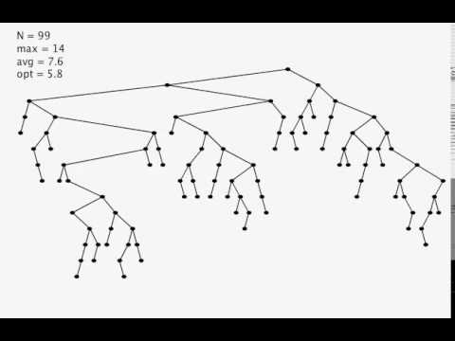
Good News: BST Insertion Demo
Video courtesy of Kevin Wayne (Princeton University)
Nice Property. Random inserts take on average only Θ(log N) each.

Slide 107
Binary Search Trees: Operations
Other typical Map<K, V> operations.
insert(K, V)
remove(K)
Ordering specific operations
min(), max()
getAllGreaterThan(K key), getAllLessThan(K key)
getNthLargest(int n)
Your job to implement some of these!

